Slide 1
COMP 3500 Introduction to Operating Systems Midterm Exam 2 Review
Dr. Xiao Qin
Auburn University http://www.eng.auburn.edu/~xqin
xqin@auburn.edu

Slide 2
Condition Variables: Functions
/* Release lock, put thread to sleep until cv is signaled; when thread wakes up again, re-acquire lock before returning */
void cv_wait(struct cv *c, struct lock *mutex);
/* If any threads are waiting on cv, wake up one of them. Caller must hold lock, which must be the same as the lock used in the wait call */
void cv_signal(struct cv *c, struct lock *mutex);
Notes:
References: http://web.stanford.edu/class/cs140/cgi-bin/lecture.php?topic=locks
Operations:
cv_wait - Release the supplied lock, go to sleep, and, after
waking up again, re-acquire the lock.
cv_signal - Wake up one thread that's sleeping on this CV.
cv_broadcast - Wake up all threads sleeping on this CV.

Slide 3
Condition Variables: Functions (cont.)
struct cv *cv_create(const char *name);
void cv_destroy(struct cv *);
/* Same as signal, except wake up all waiting threads */
void cv_broadcast(struct cv *cv,
struct lock *lock);
Notes:
References: http://web.stanford.edu/class/cs140/cgi-bin/lecture.php?topic=locks
Operations:
cv_wait - Release the supplied lock, go to sleep, and, after
waking up again, re-acquire the lock.
cv_signal - Wake up one thread that's sleeping on this CV.
cv_broadcast - Wake up all threads sleeping on this CV.

Slide 4
Producer: how to use condition variables in OS/161?
void producer(char c) {
lock_acquire(mutex);
while (count == SIZE) {
cv_wait(notFull, mutex);
}
count++;
buffer[head] = c;
head++;
if (head == SIZE) {
head = 0;
}
cv_signal(notEmpty, mutex);
lock_release(mutex);
}

Slide 5
Consumer: how to use condition variables in OS/161?
char consumer() {
char c;
lock_acquire(mutex);
while (count == 0) {
cv_wait(notEmpty, mutex);
}
count--;
c = buffer[tail];
tail++;
if (tail == SIZE) {
tail = 0;
}
cv_signal(notFull, mutex);
lock_release(mutex);
return c;
}

Slide 6
Can a deadlock occur?
p 0 p 1 q 0 q 1 p 2 q 2
Slide courtesy of Dr. William Stallings
Notes:
As an example of deadlock involving reusable resources, consider two processes that compete for exclusive access to a disk file D and a tape drive T. The programs engage in the operations depicted in Figure 6.4 . Deadlock occurs if each process holds one resource and requests the other. For example, deadlock occurs if the multiprogramming system interleaves the execution of the two processes as follows:
p 0 p 1 q 0 q 1 p 2 q 2
It may appear that this is a programming error rather than a problem for the OS designer. However, we have seen that concurrent program design is challenging. Such deadlocks do occur, and the cause is often embedded in complex program logic, making detection difficult. One strategy for dealing with such a deadlock is to impose system design constraints concerning the order in which resources can be requested.

Slide 7

Deadlock Characterization
Deadlock can arise if four conditions hold simultaneously.
1. Mutual exclusion: only one process at a time can use a resource

Slide 8

Deadlock Characterization
Deadlock can arise if four conditions hold simultaneously.
2. Hold and wait: a process holding at least one resource is waiting to acquire additional resources held by other processes

Slide 9


Deadlock Characterization
Deadlock can arise if four conditions hold simultaneously.
3.No preemption: a resource can be released only voluntarily by the process holding it, after that process has completed its task

Slide 10
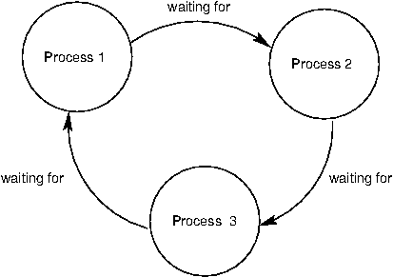
Deadlock Characterization
Deadlock can arise if four conditions hold simultaneously.
4. Circular wait:
a set {P₀, P₁, …, P_{n}} of waiting processes
P₀ is waiting for a resource that is held by P₁,
P₁ is waiting for a resource that is held by P₂, …,
P_{n–1} is waiting for a resource that is held by P_{n}, and
P_{n} is waiting for a resource that is held by P₀.

Slide 11
Resource-Allocation Graph
Process
Resource Type with 4 instances
P_{i} requests instance of R_{j}
P_{i} is holding an instance of R_{j}
P_{i}
R_{j}
P_{i}
R_{j}

Slide 12
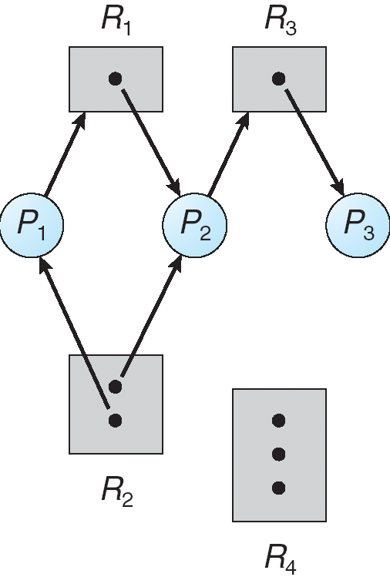
Can you explain this resource allocation graph?

Slide 13
Handling Deadlocks
Three general approaches to dealing with deadlock:
Prevent Deadlock
adopt a policy that eliminates one of the conditions
Avoid Deadlock
make the appropriate dynamic choices based on the current state of resource allocation
Detect Deadlock
attempt to detect the presence of deadlock and take action to recover
Notes:
Ensure that the system will never enter a deadlock state:
Deadlock prevention
Deadlock avoidence
Allow the system to enter a deadlock state and then recover
Ignore the problem and pretend that deadlocks never occur in the system; used by most operating systems, including UNIX

Slide 14
Deadlock Prevention (1)
Mutual Exclusion
Can you propose the first deadlock prevention approach?
not required for sharable resources (e.g., read-only files); must hold for non-sharable resources

Slide 15
Deadlock Prevention (2)
Hold and Wait
Can you propose the second deadlock prevention approach?
Idea: Must guarantee that whenever a process requests a resource, it does not hold any other resources
Protocol 1: Require process to request and be allocated all its resources before it begins execution
Protocol 2: Allow process to request resources only when the process has none allocated to it.
Problems?
Low resource utilization; starvation possible
Notes:
Use CD, HDD, Printer as an example to show the differences between protocol 1 and protocol 2.

Slide 16
Deadlock Prevention (3)
No Preemption
Can you propose the third deadlock prevention approach?
If a process that is holding some resources requests another resource that cannot be immediately allocated to it, then all resources currently being held are released
Preempted resources are added to the list of resources for which the process is waiting
Process will be restarted only when it can regain its old resources, as well as the new ones that it is requesting

Slide 17
Deadlock Prevention (Cont.)
Circular Wait
Can you propose the fourth deadlock prevention approach? (Difficult)
Impose a total ordering of all resource types, and require that each process requests resources in an increasing order of enumeration

Slide 18
Deadlock Avoidance
Requires that a system has some additional a priori information available
Simplest and most useful model requires that each process declare the maximum number of resources of each type that it may need
The deadlock-avoidance algorithm dynamically examines the resource-allocation state to ensure that there can never be a circular-wait condition
Resource-allocation state is defined by the number of available and allocated resources, and the maximum demands of the processes

Slide 19
Deadlock Avoidance Advantages
I
Disallow
Safe States
Unsafe States
Deadlock States
Slide courtesy of Dr. Gary Nutt
Notes:
Deadlock avoidance has the advantage that it is not necessary to preempt and
rollback processes, as in deadlock detection, and is less restrictive than deadlock
prevention.
If a system is in safe state ⇒ no deadlocks
If a system is in unsafe state ⇒ possibility of deadlock
Avoidance ⇒ ensure that a system will never enter an unsafe state.

Slide 20
Safe State
When a process requests a resource, system must decide if allocation leaves the system in a safe state
System is in safe state if there exists a sequence <P₁, P₂, …, P_{n}> of ALL the processes in the systems such that for each P_{i}, the resources that P_{i} can still request can be satisfied by currently available resources + resources held by all the P_{j}, with j < I
Notes:
When a process requests a resource, system must decide if allocation leaves the system in a safe state
System is in safe state if there exists a sequence <P₁, P₂, …, P_{n}> of ALL the processes in the systems such that for each P_{i}, the resources that P_{i} can still request can be satisfied by currently available resources + resources held by all the P_{j}, with j < I
That is:
If P_{i} resource needs are not immediately available, then P_{i} can wait until all P_{j} have finished
When P_{j} is finished, P_{i} can obtain needed resources, execute, return allocated resources, and terminate
When P_{i} terminates, P_{i +1} can obtain its needed resources, and so on

Slide 21
Avoidance Algorithms
Single instance of a resource type
Use a resource-allocation graph
Multiple instances of a resource type
Use the banker’s algorithm

Slide 22
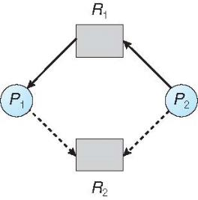
Resource-Allocation Graph Scheme
Claim edge P_{i} → R_{j} indicated that process P_{j} may request resource R_{j}; represented by a dashed line
Claim edge converts to request edge when a process requests a resource
Request edge converted to an assignment edge when the resource is allocated to the process
When a resource is released by a process, assignment edge reconverts to a claim edge
Resources must be claimed a priori in the system
Notes:
Claim edge P_{i} → R_{j} indicated that process P_{j} may request resource R_{j}; represented by a dashed line
Claim edge converts to request edge when a process requests a resource
Request edge converted to an assignment edge when the resource is allocated to the process
When a resource is released by a process, assignment edge reconverts to a claim edge
Resources must be claimed a priori in the system

Slide 23
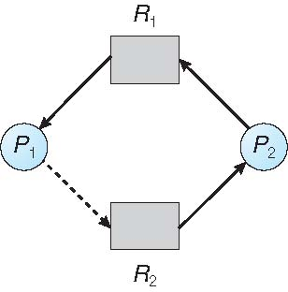
Resource-Allocation Graph Algorithm
What is the basic idea?
Suppose that process P_{i} requests a resource R_{j}
The request can be granted only if converting the request edge to an assignment edge does not result in the formation of a cycle in the resource allocation graph
What is a problem here?
It is not applicable to a system with multiple instances of each resource type

Slide 24
Banker’s Algorithm
Multiple instances
Each process must declare maximum use
When a process requests a resource it may have to wait
When a process gets all its resources it must return them in a finite amount of time

Slide 25
Data Structures for the Banker’s Algorithm
Let n = number of processes, and m = number of resources types.
Available: Vector of length m. If available [j] = k, there are k instances of resource type R_{j} available
Max: n x m matrix. If Max [i,j] = k, then process P_{i} may request at most k instances of resource type R_{j}
Allocation: n x m matrix. If Allocation[i,j] = k then P_{i} is currently allocated k instances of R_{j}
Need: n x m matrix. If Need[i,j] = k, then P_{i} may need k more instances of R_{j} to complete its task
Need [i,j] = Max[i,j] – Allocation [i,j]

Slide 26
Example of Banker’s Algorithm
5 processes P₀ through P₄;
3 resource types:
A (10 instances), B (5instances), and C (7 instances)
Snapshot at time T₀:
Allocation Max Available
A B C A B C A B C
P₀ 0 1 0 7 5 3 3 3 2
P₁ 2 0 0 3 2 2
P₂ 3 0 2 9 0 2
P₃ 2 1 1 2 2 2
P₄ 0 0 2 4 3 3

Slide 27
Example (Cont.)
The content of the matrix Need is defined to be Max – Allocation
Need
A B C
P₀ 7 4 3
P₁ 1 2 2
P₂ 6 0 0
P₃ 0 1 1
P₄ 4 3 1
The system is in a safe state since the sequence < P₁, P₃, P₄, P₂, P₀> satisfies safety criteria

Slide 28
Example: P₁ Request (1,0,2)
Check that Request ≤ Available (that is, (1,0,2) ≤ (3,3,2) ⇒ true
Allocation Need Available
A B C A B C A B C
P₀ 0 1 0 7 4 3 2 3 0
P₁ 3 0 2 0 2 0
P₂ 3 0 2 6 0 0
P₃ 2 1 1 0 1 1
P₄ 0 0 2 4 3 1
Executing safety algorithm shows that sequence < P₁, P₃, P₄, P₀, P₂> satisfies safety requirement
Can request for (3,3,0) by P₄ be granted?
Can request for (0,2,0) by P₀ be granted?
Notes:
50min: slides 1-18

Slide 29
Safety Algorithm
1. Let Work and Finish be vectors of length m and n, respectively. Initialize:
Work = Available
Finish [i] = false for i = 0, 1, …, n- 1
2. Find an i such that both:
(a) Finish [i] = false
(b) Need_{i} ≤ Work
If no such i exists, go to step 4
3. Work = Work + Allocation_{i} Finish[i] = true go to step 2
4. If Finish [i] == true for all i, then the system is in a safe state

Slide 30
Resource-Request Algorithm for Process P_{i}
Request_{i} = request vector for process P_{i}. If Request_{i} [j] = k then process P_{i} wants k instances of resource type R_{j}
1. If Request_{i} ≤ Need_{i} go to step 2. Otherwise, raise error condition, since process has exceeded its maximum claim
2. If Request_{i} ≤ Available, go to step 3. Otherwise P_{i} must wait, since resources are not available
3. Pretend to allocate requested resources to P_{i} by modifying the state as follows:
Available = Available – Request_{i};
Allocation_{i} = Allocation_{i} + Request_{i};
Need_{i} = Need_{i} – Request_{i};
If safe ⇒ the resources are allocated to P_{i}
If unsafe ⇒ P_{i} must wait, and the old resource-allocation state is restored

Slide 31
Processor Scheduling
Goal: to assign processes to be executed by the processor in a way that meets system objectives, such as?
Broken down into three separate functions:
Response time, throughput, and processor efficiency
long term scheduling
medium term scheduling
short term scheduling
Notes:
The aim of processor scheduling is to assign processes to be executed by the processor
or processors over time, in a way that meets system objectives, such as response
time, throughput, and processor efficiency. In many systems, this scheduling activity
is broken down into three separate functions: long-, medium-, and short-term
scheduling. The names suggest the relative time scales with which these functions are
performed.

Slide 32
Model of Process Execution
Preemption or voluntary yield
New
Process
Ready
List
Scheduler
CPU
Done
job
job
“Running”
job
“Ready”
Resource
Manager
Allocate
Request
job
job
“Blocked”
Resources
Running jobs (processes) may cease using the CPU for which four reasons?
Slide courtesy of Dr. Gary Nutt
Notes:
Time out
Wait for I/Os
Be preempted
Done
Wait for event (synchronization)

Slide 33
How many different potential schedules?
A CPU scheduler determines an order for the execution of its scheduled proceses.
Given n processes to be scheduled
n factorial n!
Notes:
The aim of processor scheduling is to assign processes to be executed by the processor
or processors over time, in a way that meets system objectives, such as response
time, throughput, and processor efficiency. In many systems, this scheduling activity
is broken down into three separate functions: long-, medium-, and short-term
scheduling. The names suggest the relative time scales with which these functions are
performed.

Slide 34
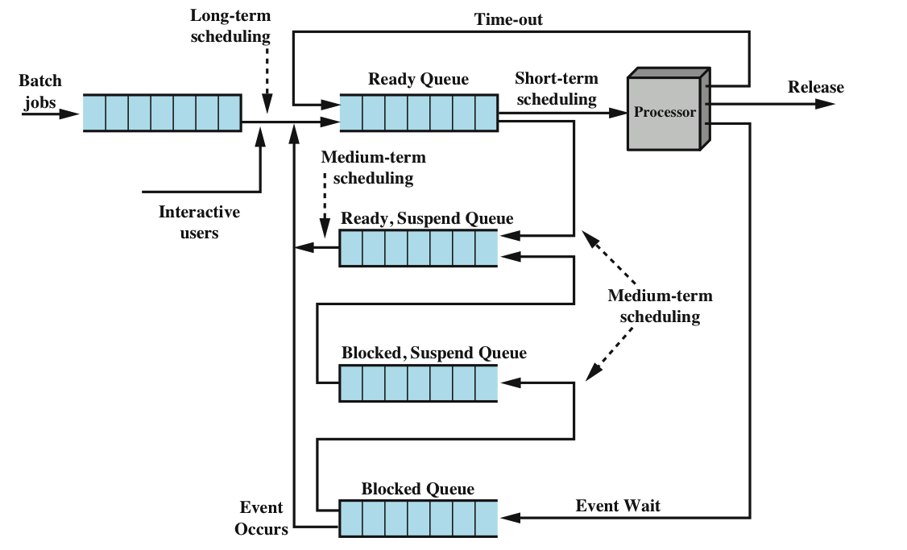
Where are Long term, medium term, short term scheduling?

Slide 35
Can you propose scheduling criteria?
CPU utilization – keep the CPU as busy as possible
Throughput – # of processes that complete their execution per time unit
Turnaround time – amount of time to execute a particular process
Waiting time – amount of time a process has been waiting in the ready queue
Response time – amount of time it takes from when a request was submitted until the first response is produced, not output (for time-sharing environment)
Notes:
See also Exercise 1.
Max CPU utilization
Max throughput
Min turnaround time
Min waiting time
Min response time
The main objective of short-term scheduling is to allocate processor time in such
a way as to optimize one or more aspects of system behavior. Generally, a set of
criteria is established against which various scheduling policies may be evaluated.
The commonly used criteria can be categorized along two dimensions. First,
we can make a distinction between user-oriented and system-oriented criteria.
User-oriented criteria relate to the behavior of the system as perceived by the
individual user or process. An example is response time in an interactive system.
Response time is the elapsed time between the submission of a request until the
response begins to appear as output. This quantity is visible to the user and is
naturally of interest to the user. We would like a scheduling policy that provides
“good” service to various users. In the case of response time, a threshold may be
defined, say two seconds. Then a goal of the scheduling mechanism should be to
maximize the number of users who experience an average response time of two
seconds or less.
Other criteria are system oriented. That is, the focus is on effective and
efficient utilization of the processor. An example is throughput, which is the rate
at which processes are completed. This is certainly a worthwhile measure of system
performance and one that we would like to maximize. However, it focuses on
system performance rather than service provided to the user. Thus, throughput is of
concern to a system administrator but not to the user population.
Whereas user-oriented criteria are important on virtually all systems, system-oriented
criteria are generally of minor importance on single-user systems. On a
single-user system, it probably is not important to achieve high processor utilization
or high throughput as long as the responsiveness of the system to user applications
is acceptable.

Slide 36
Scheduling Criteria
Criteria can be classified into:
Performance-related
quantitative
easily measured
Non-performance related
qualitative
hard to measure
examples:
response time
throughput
example:
Predictability
Usability
Notes:
Max CPU utilization
Max throughput
Min turnaround time
Min waiting time
Min response time
The main objective of short-term scheduling is to allocate processor time in such
a way as to optimize one or more aspects of system behavior. Generally, a set of
criteria is established against which various scheduling policies may be evaluated.
The commonly used criteria can be categorized along two dimensions. First,
we can make a distinction between user-oriented and system-oriented criteria.
User-oriented criteria relate to the behavior of the system as perceived by the
individual user or process. An example is response time in an interactive system.
Response time is the elapsed time between the submission of a request until the
response begins to appear as output. This quantity is visible to the user and is
naturally of interest to the user. We would like a scheduling policy that provides
“good” service to various users. In the case of response time, a threshold may be
defined, say two seconds. Then a goal of the scheduling mechanism should be to
maximize the number of users who experience an average response time of two
seconds or less.
Other criteria are system oriented. That is, the focus is on effective and
efficient utilization of the processor. An example is throughput, which is the rate
at which processes are completed. This is certainly a worthwhile measure of system
performance and one that we would like to maximize. However, it focuses on
system performance rather than service provided to the user. Thus, throughput is of
concern to a system administrator but not to the user population.
Whereas user-oriented criteria are important on virtually all systems, system-oriented
criteria are generally of minor importance on single-user systems. On a
single-user system, it probably is not important to achieve high processor utilization
or high throughput as long as the responsiveness of the system to user applications
is acceptable.

Slide 37
Wait Time vs. Turnaround Time
Let P = {p_{i} | 0 ≤ i < n} = set of processes
Let S(p_{i}) ∈ {running, ready, blocked}
Let t(p_{i}) = Time process needs to be in running state (the service time)
Let W(p_{i}) = Time p_{i} is in ready state before first transition to running (wait time)
Let T_{TRnd}(p_{i}) = Time from p_{i} first enter ready to last exit ready (turnaround time)
Batch Throughput rate = inverse of avg T_{TRnd}
Timesharing response time = W(p_{i})

Slide 38
First-Come-First-Served
i τ(p_{i})
0 350
1 125
2 475
3 250
4 75
0
350
p₀
T_{TRnd}(p₀) = τ(p₀) = 350
W(p₀) = 0

Slide 39
FCFS Average Wait Time
Pros and Cons
Easy to implement
Ignores service time, etc
Not a great performer
i τ(p_{i})
0 350
1 125
2 475
3 250
4 75
0
350
475
900
1200
1275
p₀
p₁
p₂
p₃
p₄
T_{TRnd}(p₀) = τ(p₀) = 350
T_{TRnd}(p₁) = (τ(p₁) +T_{TRnd}(p₀)) = 125+350 = 475
T_{TRnd}(p₂) = (τ(p₂) +T_{TRnd}(p₁)) = 475+475 = 950
T_{TRnd}(p₃) = (τ(p₃) +T_{TRnd}(p₂)) = 250+950 = 1200
T_{TRnd}(p₄) = (τ(p₄) +T_{TRnd}(p₃)) = 75+1200 = 1275
W(p₀) = 0
W(p₁) = T_{TRnd}(p₀) = 350
W(p₂) = T_{TRnd}(p₁) = 475
W(p₃) = T_{TRnd}(p₂) = 950
W(p₄) = T_{TRnd}(p₃) = 1200
W_{TRand_avg} = 850
W_{avg} = (0+350+475+950+1200)/5 = 2974/5 = 595

Slide 40
Shortest Job Next
i τ(p_{i})
0 350
1 125
2 475
3 250
4 75
0
75
p₄
T_{TRnd}(p₄) = τ(p₄) = 75
W(p₄) = 0
Notes:
Associate with each process the length of its next CPU burst
Use these lengths to schedule the process with the shortest time
SJF is optimal – gives minimum average waiting time for a given set of processes
The difficulty is knowing the length of the next CPU request
Could ask the user

Slide 41
Shortest Job Next
i τ(p_{i})
0 350
1 125
2 475
3 250
4 75
Minimizes wait time
May starve large jobs
Must know service times
Pros and Cons
0
75
200
450
800
1275
p₄
p₁
p₃
p₀
p₂
T_{TRnd}(p₀) = τ(p₀)+τ(p₃)+τ(p₁)+τ(p₄) = 350+250+125+75 = 800
T_{TRnd}(p₁) = τ(p₁)+τ(p₄) = 125+75 = 200
T_{TRnd}(p₂) = τ(p₂)+τ(p₀)+τ(p₃)+τ(p₁)+τ(p₄) = 475+350+250+125+75
= 1275
T_{TRnd}(p₃) = τ(p₃)+τ(p₁)+τ(p₄) = 250+125+75 = 450
T_{TRnd}(p₄) = τ(p₄) = 75
W(p₀) = 450
W(p₁) = 75
W(p₂) = 800
W(p₃) = 200
W(p₄) = 0
W_{TRand_avg} = 560
W_{avg} = (450+75+800+200+0)/5 = 1525/5 = 305

Slide 42
Priority Scheduling
i τ(p_{i}) Pri
0 350 5
1 125 2
2 475 3
3 250 1
4 75 4
Pros and Cons
Reflects importance of external use
May cause starvation
Can address starvation with aging
0
250
375
850
925
1275
p₃
p₁
p₂
p₄
p₀
T_{TRnd}(p₀) = τ(p₀)+τ(p₄)+τ(p₂)+τ(p₁) )+τ(p₃) = 350+75+475+125+250
= 1275
T_{TRnd}(p₁) = τ(p₁)+τ(p₃) = 125+250 = 375
T_{TRnd}(p₂) = τ(p₂)+τ(p₁)+τ(p₃) = 475+125+250 = 850
T_{TRnd}(p₃) = τ(p₃) = 250
T_{TRnd}(p₄) = τ(p₄)+ τ(p₂)+ τ(p₁)+τ(p₃) = 75+475+125+250 = 925
W(p₀) = 925
W(p₁) = 250
W(p₂) = 375
W(p₃) = 0
W(p₄) = 850
W_{TRand_avg} = 735
W_{avg} = (925+250+375+0+850)/5 = 2400/5 = 480
Notes:
A priority number (integer) is associated with each process
The CPU is allocated to the process with the highest priority (smallest integer ≡ highest priority)
Preemptive
Nonpreemptive
SJF is priority scheduling where priority is the inverse of predicted next CPU burst time
Problem ≡ Starvation – low priority processes may never execute
Solution ≡ Aging – as time progresses increase the priority of the process

Slide 43
Preemptive Schedulers
Preemption or voluntary yield
New
Process
Ready
List
Scheduler
CPU
Done
Highest priority process is guaranteed to be running at all times
Or at least at the beginning of a time slice
Dominant form of contemporary scheduling
But complex to build & analyze

Slide 44
Round Robin (TQ=50)
i τ(p_{i})
0 350
1 125
2 475
3 250
4 75
0
50
p₀
W(p₀) = 0
Notes:
Each process gets a small unit of CPU time (time quantum q), usually 10-100 milliseconds. After this time has elapsed, the process is preempted and added to the end of the ready queue.
If there are n processes in the ready queue and the time quantum is q, then each process gets 1/n of the CPU time in chunks of at most q time units at once. No process waits more than (n-1)q time units.
Timer interrupts every quantum to schedule next process
Performance
q large ⇒ FIFO
q small ⇒ q must be large with respect to context switch, otherwise overhead is too high

Slide 45
RR with Overhead=10 (TQ=50)
i τ(p_{i})
0 350
1 125
2 475
3 250
4 75
Overhead must be considered
0
120
240
360
480
540
575
635
670
790
p₀
p₁
p₂
p₃
p₄
p₀
p₁
p₂
p₃
p₄
p₀
p₁
p₂
p₃
790
910
1030
1150
1270
1390
1510
1535
p₀
p₂
p₃
p₀
p₂
p₃
p₀
p₂
p₀
p₂
p₂
p₂
p₂
T_{TRnd}(p₀) = 1320
T_{TRnd}(p₁) = 660
T_{TRnd}(p₂) = 1535
T_{TRnd}(p₃) = 1140
T_{TRnd}(p₄) = 565
W(p₀) = 0
W(p₁) = 60
W(p₂) = 120
W(p₃) = 180
W(p₄) = 240
T_{TRnd}__{avg} = (1320+660+1535+1140+565)/5 = 5220/5 = 1044
W_{avg} = (0+60+120+180+240)/5 = 600/5 = 120

Slide 46
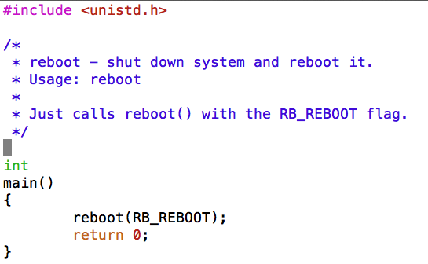
Use System Call: sys_reboot() Is this program an application or a part of the kernel? In src/sbin/reboot/reboot.c
How to run the reboot program? Type “p /sbin/reboot”
Notes:
/sbin is under ~/cs161/root
All executable code can be found here.
In a real operating system, the kernel's main function is to provide support for user-level programs. Most such support is accessed via "system calls." We give you one system call, reboot(), which is implemented in the function sys_reboot() in src/kern/main/main.c. In GDB, if you put a breakpoint on sys_reboot and run the "reboot" program (by typing "p /sbin/reboot" at the OS/161 menu prompt), you can use "backtrace" to see how it got there.

Slide 47
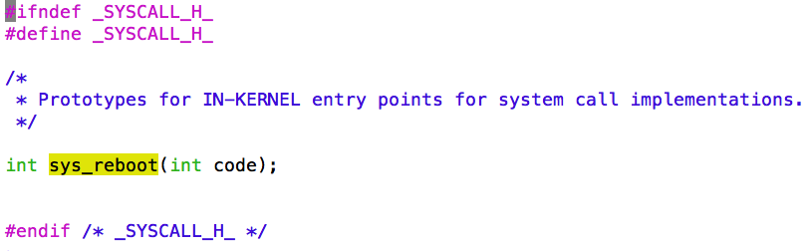
System Call: sys_reboot() In src/kern/include/syscall.h
Notes:
you have to implement the interface between user-mode programs ("userland") and the kernel. You will be provided part of the code needed for this assignment, and you are required to design and implement the missing pieces. Your job also includes implementation of the subsystem that keeps track of the multiple tasks you will have in the future. Importantly, you need to design data structures for "process" (Hint: look at kernel include files of your favorite operating system for suggestions,

Slide 48
Which function calls mips_syscall()?
exception.S
mips_trap()
mips_syscall()
See cs161/kern/arch/mips/mips
Notes:
mips_trap() and mips_syscall() can be found in cs161/kern/arch/mips/mips

Slide 49
User-Level Interface for System Calls src/include/unistd.h
This file contains the user-level interface definition of the system calls for OS/161
Note that the user-level interface defined in unistd.h is different from that of the kernel functions that you will define to implement these calls.
You need to declare the kernel functions in
src/kern/include/syscall.h
Notes:
Demonstrate file: ~/cs161/src/include/unistd.h
Also show: ~/cs161/src/kern/include/syscall.h

Slide 50
System Call Implementation
Example: getpid_syscall.c
#include <types.h>
#include <syscall.h>
#include <thread.h>
#include <curthread.h>
/* Sample implementation of sys_getpid() */
int
sys_getpid(pid_t *retval)
{
*retval = curthread->t_pid;
return 0;
}

Slide 51
System Call Implementation
Update data structure struct thread in kern/include/thread.h by adding the following data item:
pid_t t_pid;
Notes:
Show source code file: ~/cs161/src/kern/include/thread.h

Slide 52
Update Configuration File and Reconfigure the Project
Now you can update the configuration file (i.e., conf.kern) located in src/kern/conf
The following line should be added:
file userprog/getpid_syscall.c
Reconfigure the project (see Step 1 for details)
Notes:
Show conf.kern

Slide 53
Update the header file of system call functions in the kernel
The prototype of sys_getpid may be included in the following file:
~/cs161/src/kern/include/syscall.h
Add the following function prototype in the above file:
int sys_getpid(pid_t *retval);

Slide 54
The Basic Memory Hierarchy
CPU Registers
Less Frequently Used Information
Primary Memory
(Executable Memory)
e.g. RAM
Faster access
Larger storage
More Frequently Used Information
Secondary Memory
e.g. Disk or Tape
Speed?
Q1: Capacity?
Slide courtesy of Dr. Gary Nutt
Notes:
While surveying the various mechanisms and policies associated with memory management, it is helpful to keep in mind the requirements that memory management is intended to satisfy. These requirements include the following:
• Relocation
• Protection
• Sharing
• Logical organization
• Physical organization

Slide 55
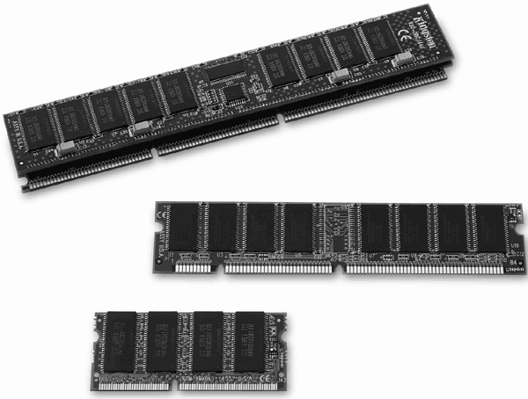
Memory Management Requirements Can you list two functionalities?
Relocation
Protection
Sharing
Logical organization
Physical organization
Notes:
While surveying the various mechanisms and policies associated with memory management, it is helpful to keep in mind the requirements that memory management is intended to satisfy. These requirements include the following:
• Relocation
• Protection
• Sharing
• Logical organization
• Physical organization

Slide 56
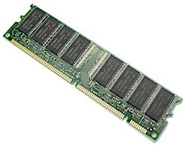
Address Space vs. Primary Memory
Hardware Primary Memory
Process Address Space
Mapped to object
other than memory
Notes:
In a multiprogramming system, the available main memory is generally shared among a number of processes. Typically, it is not possible for the programmer to know in advance which other programs will be resident in main memory at the time of execution of his or her program. In addition, we would like to be able to swap active processes in and out of main memory to maximize processor utilization by providing a large pool of ready processes to execute. Once a program is swapped out to disk, it would be quite limiting to specify that when it is next swapped back in, it must be placed in the same main memory region as before. Instead, we may need to relocate the process to a different area of memory.

Slide 57
Creating an Executable Program
Source
code
Library
code
Other
objects
Secondary
memory
C
Reloc
Object
code
Link
Edit
Primary
memory
Compile time: Translate elements
Link time: Combine elements
Loader
Process
address
space
Load time:
Allocate primary memory
Adjust addresses in address space
Copy address space from secondary to primary memory
Notes:
Dynamic Linking
Linking postponed until execution time
Small piece of code, stub, used to locate the appropriate memory-resident library routine
Stub replaces itself with the address of the routine, and executes the routine
Operating system needed to check if routine is in processes’ memory address
Dynamic linking is particularly useful for libraries

Slide 58
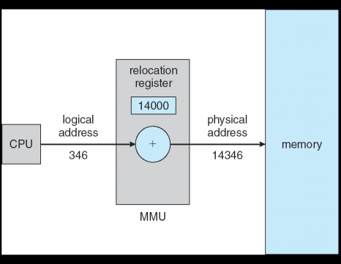
Dynamic Relocation using a Relocation Register
Hardware device that maps virtual to physical address
The value in the relocation register is added to every address generated by a user process at the time it is sent to memory
The user program deals with logical addresses; it never sees the real physical addresses

Slide 59
Static Memory Partitioning
Unused
Operating
System
In Use
Used in several variations in some now-obsolete operating systems
Does not involve virtual memory
Process 3
p_{i}
Process 0
Issue:
Need a mechanism/policy for loading p_{i}’s address space into primary memory
Process 2
Process 1
Notes:
The principal operation of memory management is to bring processes into main memory for execution by the processor. In almost all modern multiprogramming systems, this involves a sophisticated scheme known as virtual memory. Virtual memory is, in turn, based on the use of one or both of two basic techniques: segmentation and paging. Before we can look at these virtual memory techniques, we must prepare the ground by looking at simpler techniques that do not involve virtual memory ( Table 7.2 summarizes all the techniques examined in this chapter and the next). One of these techniques, partitioning, has been used in several variations in some now-obsolete operating systems. The other two techniques, simple paging and simple segmentation, are not used by themselves. However, it will clarify the discussion of virtual memory if we look first at these two techniques in the absence of virtual memory considerations.

Slide 60
Frame vs. Page vs. Segment
Memory Management Terms
Notes:
In a uniprogramming system, main memory is divided into two parts: one part
for the operating system (resident monitor, kernel) and other part for the program
currently being executed. In a multiprogramming system, the “user” part of
memory must be further subdivided to accommodate multiple processes. The task
of subdivision is carried out dynamically by the operating system and is known as
memory management .
Effective memory management is vital in a multiprogramming system. If only
a few processes are in memory, then for much of the time all of the processes will be
waiting for I/O (input/output) and the processor will be idle. Thus memory needs to
be allocated to ensure a reasonable supply of ready processes to consume available
processor time.
Table 7.1 introduces some key terms for our discussion.

Slide 61
Static Memory Allocation (Cont.)
Hole – block of available memory; holes of various size are scattered throughout memory
When a process arrives, it is allocated memory from a hole large enough to accommodate it
Operating system maintains information about: a) allocated partitions b) free partitions (hole)
OS
OS
OS
OS
process 5
process 5
process 5
process 5
process 9
process 9
process 8
process 10
process 2
process 2
process 2
process 2

Slide 62
Fixed-Partition Memory Mechanism
Operating
System
p_{i} needs n_{i} units
Region 0
N₀
n_{i}
p_{i}
Region 1
N₁
Region 2
N₂
Region 3
N₃

Slide 63
Fixed-Partition Memory Best-Fit
Loader must adjust every address in the absolute module when placed in memory
Operating
System
Region 0
N₀
Region 1
N₁
Internal
Fragmentation
Q4: Pros and Cons?
p_{i}
N₂
Region 2
Region 3
N₃

Slide 64
Fixed-Partition Memory Worst-Fit
Operating
System
Q5: Pros and Cons?
p_{i}
Region 0
N₀
Region 1
N₁
Region 2
N₂
Region 3
N₃
Notes:
Timesharing systems forced OS away from fixed-partition strategies

Slide 65
Fixed-Partition Memory First-Fit
Operating
System
Q6: Pros and Cons?
p_{i}
Region 0
N₀
Region 1
N₁
Region 2
N₂
Region 3
N₃

Slide 66
Fixed-Partition Memory Next-Fit
Operating
System
Q7: Pros and Cons?
Fixed-Partition strategies were used in batch multiprogramming systems (why?)
Not good for timesharing systems
Region 0
N₀
p_{i}
Region 1
N₁
P_{i+1}
Region 2
N₂
Region 3
N₃
Notes:
Know memory requirement in advance

Slide 67
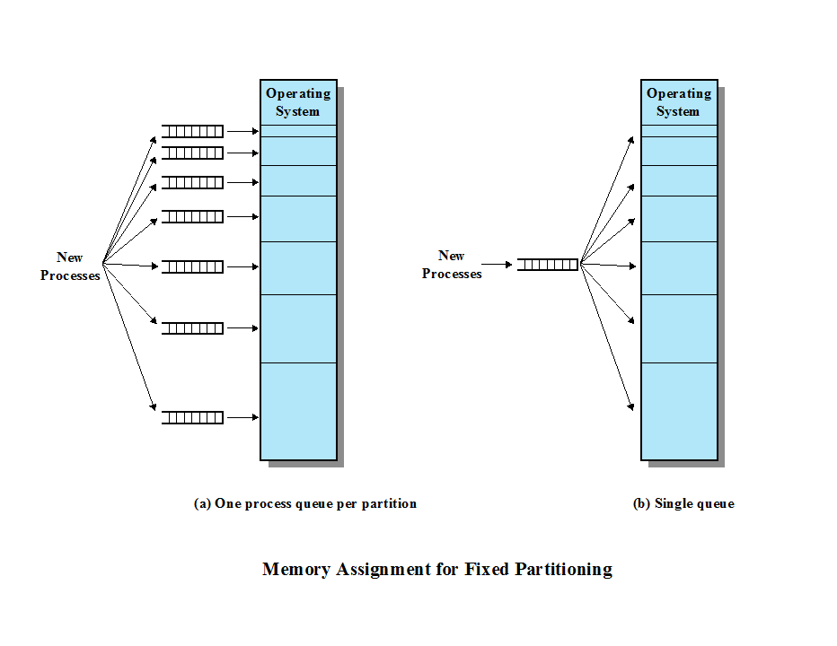
Fixed Partitioning
Which design will you choose to implement? Why?
Wasted Memory?
Overall Performance?
Notes:
Question: Which one will you pick?
PLACEMENT ALGORITHM With equal-size partitions, the placement of processes in memory is trivial. As long as there is any available partition, a process can be loaded into that partition. Because all partitions are of equal size, it does not matter which partition is used. If all partitions are occupied with processes that are not ready to run, then one of these processes must be swapped out to make room for a new process. Which one to swap out is a scheduling decision; this topic is explored in Part Four.
With unequal-size partitions, there are two possible ways to assign processes to partitions. The simplest way is to assign each process to the smallest partition within which it will fit. In this case, a scheduling queue is needed for each partition, to hold swapped-out processes destined for that partition ( Figure 7.3a ). The advantage of this approach is that processes are always assigned in such a way as to minimize wasted memory within a partition (internal fragmentation).
Although this technique seems optimum from the point of view of an individual partition, it is not optimum from the point of view of the system as a whole. In Figure 7.2b , for example, consider a case in which there are no processes with a size between 12 and 16M at a certain point in time. In that case, the 16M partition will remain unused, even though some smaller process could have been assigned to it. Thus, a preferable approach would be to employ a single queue for all processes ( Figure 7.3b ). When it is time to load a process into main memory, the smallest available partition that will hold the process is selected. If all partitions are occupied, then a swapping decision must be made. Preference might be given to swapping out of the smallest partition that will hold the incoming process. It is also possible to consider other factors, such as priority, and a preference for swapping out blocked
processes versus ready processes.

Slide 68
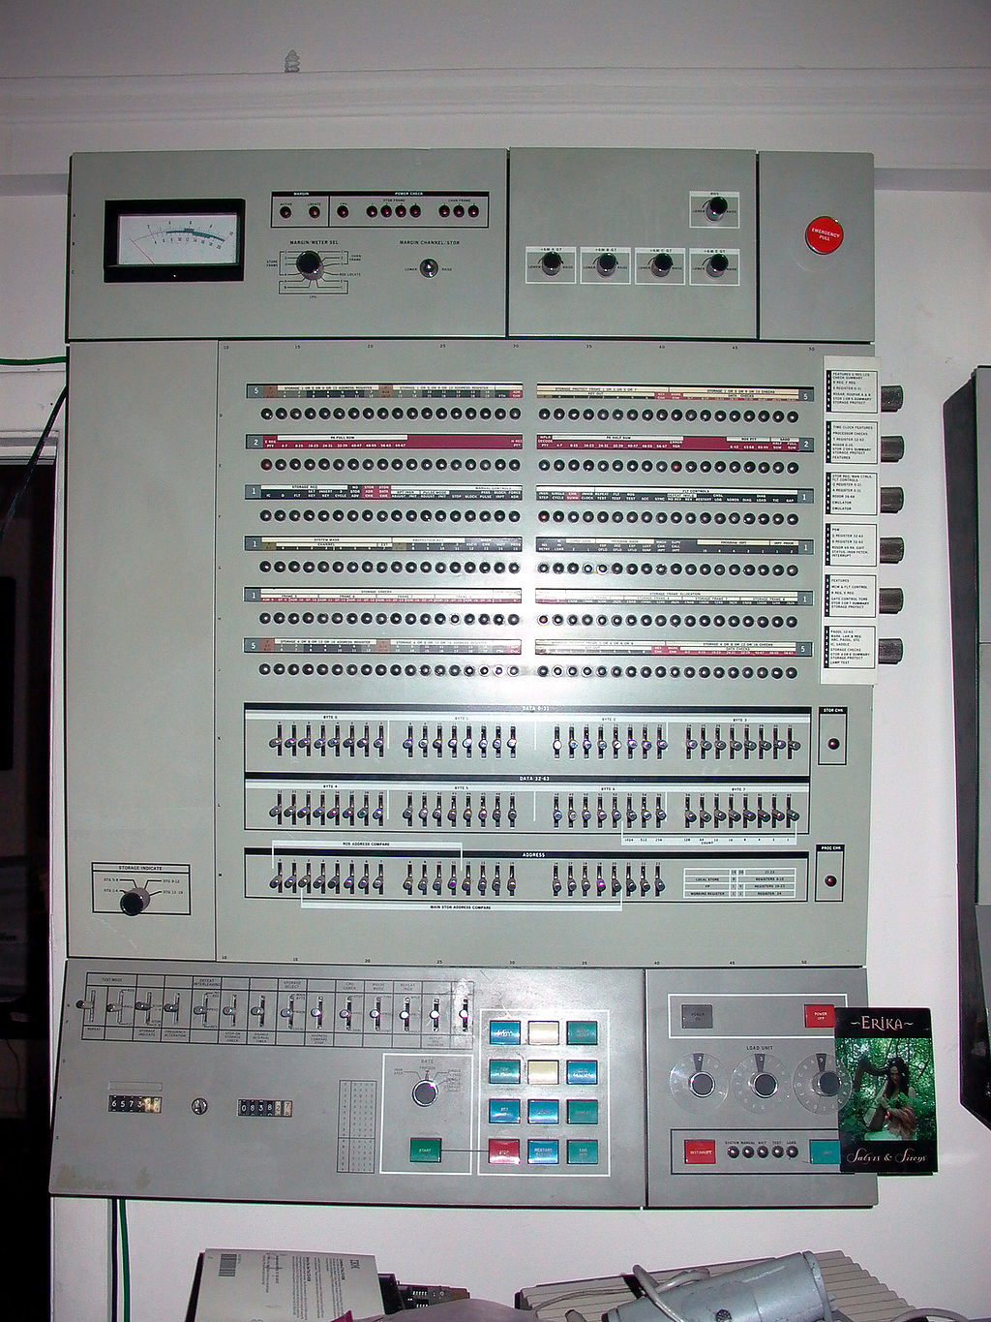
Dynamic Partitioning
Partitions are of variable length and number
Process is allocated exactly as much memory as it requires
This technique was used by IBM’s mainframe operating system, OS/MVT
Notes:
To overcome some of the difficulties with fixed partitioning, an approach known as dynamic partitioning was developed. Again, this approach has been supplanted by more sophisticated memory management techniques. An important operating system that used this technique was IBM’s mainframe operating system, OS/MVT (Multiprogramming with a Variable Number of Tasks).
With dynamic partitioning, the partitions are of variable length and number. When a process is brought into main memory, it is allocated exactly as much memory as it requires and no more.
OS/360, officially known as IBM System/360 Operating System,[1][2] is a discontinued batch processing operating system developed by IBM for their then-new System/360 mainframe computer, announced in 1964; it was heavily influenced by the earlier IBSYS/IBJOB and Input/Output Control System (IOCS) packages. It was among the earliest operating systems to make direct access storage devices a prerequisite for their operation.
Multiprogramming with a Variable number of Tasks (MVT)[14] was the most sophisticated of three available configurations of OS/360's control program.[2] MVT was intended for the largest machines in the System/360 family. Introduced in 1964, it did not become available until 1967. Early versions had many problems and the simpler MFT continued to be used for many years.

Slide 69
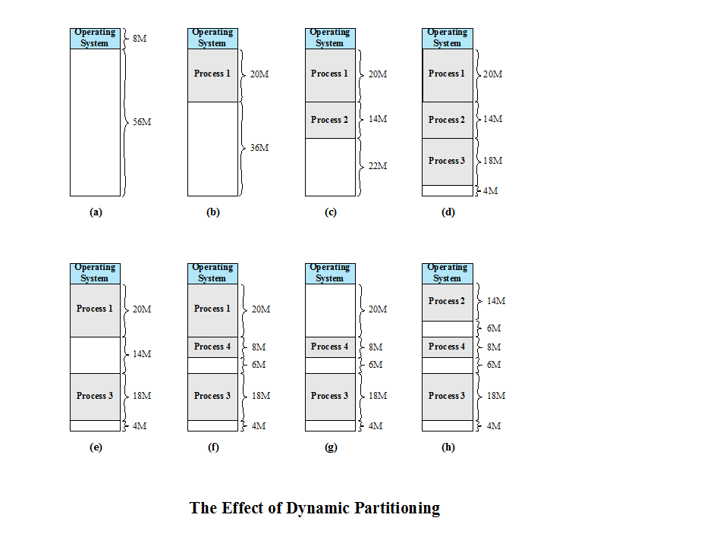
Ex2: What is a problem with dynamic partitioning?
Small holes.
Notes:
An example, using 64 Mbytes of main memory. Initially, main memory is empty, except for the OS (a). The first three processes are loaded in, starting where the operating system ends and occupying just enough space for each process (b, c, d). This leaves a “hole” at the end of memory that is too small for a fourth process. At some point, none of
the processes in memory is ready. The operating system swaps out process 2 (e), which leaves sufficient room to load a new process, process 4 (f). Because process 4 is smaller than process 2, another small hole is created. Later, a point is reached at which none of the processes in main memory is ready, but process 2, in the Ready-Suspend state, is available. Because there is insufficient room in memory for process 2, the operating system swaps process 1 out (g) and swaps process 2 back in (h).
Problem: As this example shows, this method starts out well, but eventually it leads to a situation in which there are a lot of small holes in memory. As time goes on, memory becomes more and more fragmented, and memory utilization declines. This phenomenon is referred to as external fragmentation , indicating that the memory that is external to all partitions becomes increasingly fragmented. This is in contrast to internal fragmentation, referred to earlier.

Slide 70
What is a solution to the fragmentation problem?
External Fragmentation
memory becomes more and more fragmented
memory utilization declines
Compaction
technique for overcoming external fragmentation
OS shifts processes so that they are contiguous
free memory is together in one block
time consuming and wastes CPU time (Why?)
Notes:
One technique for overcoming external fragmentation is compaction : From time to time, the OS shifts the processes so that they are contiguous and so that all of the free memory is together in one block. For example, in Figure 7.4h , compaction will result in a block of free memory of length 16M. This may well be sufficient to load in an additional process. The difficulty with compaction is that it is a time-consuming procedure and wasteful of processor time. Note that compaction implies the need for a dynamic relocation capability. That is, it must be possible to move a program from one region to another in main memory without invalidating the memory references in the program (see Appendix 7A).

Slide 71
Placement Algorithms
Best-fit
chooses the block that is closest in size to the request
First-fit
begins to scan memory from the beginning and chooses the first available block that is large enough
Next-fit
begins to scan memory from the location of the last placement and chooses the next available block that is large enough
Notes:
Because memory compaction is time consuming, the OS designer must be clever in deciding how to assign processes to memory (how to plug the holes). When it is time to load or swap a process into main memory, and if there is more than one free block of memory of sufficient size, then the operating system must decide which free block to allocate.
Three placement algorithms that might be considered are best-fit, first-fit, and next-fit. All, of course, are limited to choosing among free blocks of main memory that are equal to or larger than the process to be brought in. Best-fit chooses the block that is closest in size to the request. First-fit begins to scan memory from the beginning and chooses the first available block that is large enough. Next-fit begins to scan memory from the location of the last placement, and chooses the next available block that is large enough.

Slide 72
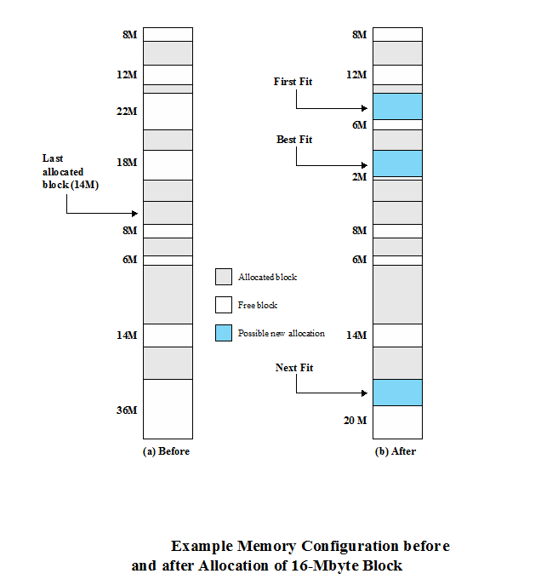
Which slot do Best-Fit, First-Fit, and Next-Fit allocate for 16-MB block?
Notes:
Figure 7.5a shows an example memory configuration after a number of placement and swapping-out operations. The last block that was used was a 22-Mbyte block from which a 14-Mbyte partition was created. Figure 7.5b shows the difference between the best-, first-, and next-fit placement algorithms in satisfying a 16-Mbyte allocation request. Best-fit will search the entire list of available blocks and make use of the 18-Mbyte block, leaving a 2-Mbyte fragment. First-fit results in a 6-Mbyte fragment, and next-fit results in a 20-Mbyte fragment.
Which of these approaches is best will depend on the exact sequence of process swapping that occurs and the size of those processes. However, some general comments can be made (see also [BREN89], [SHOR75], and [BAYS77]). The first-fit algorithm is not only the simplest but usually the best and fastest as well. The next-fit algorithm tends to produce slightly worse results than the first-fit. The next-fit algorithm will more frequently lead to an allocation from a free block at the end of memory. The result is that the largest block of free memory, which usually appears at the end of the memory space, is quickly broken up into small fragments. Thus, compaction may be required more frequently with next-fit. On the other hand, the first-fit algorithm may litter the front end with small free partitions that need to be searched over on each subsequent first-fit pass. The best-fit algorithm, despite its name, is usually the worst performer. Because this algorithm looks for the smallest block that will satisfy the requirement, it guarantees that the fragment left behind is as small as possible. Although each memory request always wastes the smallest amount of memory, the result is that main memory is quickly littered by blocks too small to satisfy memory allocation requests. Thus, memory compaction must be done more frequently than with the other algorithms.

Slide 73
Buddy System
Comprised of fixed and dynamic partitioning schemes
Space available for allocation is treated as a single block
Memory blocks are available of size 2^{K} words, L ≤ K ≤ U, where
2^{L} = smallest size block that is allocated
2^{U} = largest size block that is allocated; generally 2^{U} is the size of the entire memory available for allocation
Notes:
Both fixed and dynamic partitioning schemes have drawbacks. A fixed partitioning scheme limits the number of active processes and may use space inefficiently if there is a poor match between available partition sizes and process sizes. A dynamic partitioning scheme is more complex to maintain and includes the overhead of compaction. An interesting compromise is the buddy system ([KNUT97], [PETE77]).
Memory blocks are available of size 2^{K} words, L ≤ K ≤ U, where
2^{L} = smallest size block that is allocated
2^{U} = largest size block that is allocated; generally 2^{U} is the size of the entire memory available for allocation
To begin, the entire space available for allocation is treated as a single block of size 2^{U} . If a request of size s such that 2^{U –1} ≤ s 2^{U} is made, then the entire block is allocated. Otherwise, the block is split into two equal buddies of size 2^{U –1} . If 2^{U –2 ≤} ≤ s 2^{U –1} , then the request is allocated to one of the two buddies. Otherwise, one of the buddies is split in half again. This process continues until the smallest block greater than or equal to s is generated and allocated to the request. At any time, the buddy system maintains a list of holes (unallocated blocks) of each size 2 ^{i} . A hole may be removed from the ( i + 1) list by splitting it in half to create two buddies of size 2 ^{i} in the i list. Whenever a pair of buddies on the i list both become unallocated, they are removed from that list and coalesced into a single block on the ( i + 1) list.

Slide 74
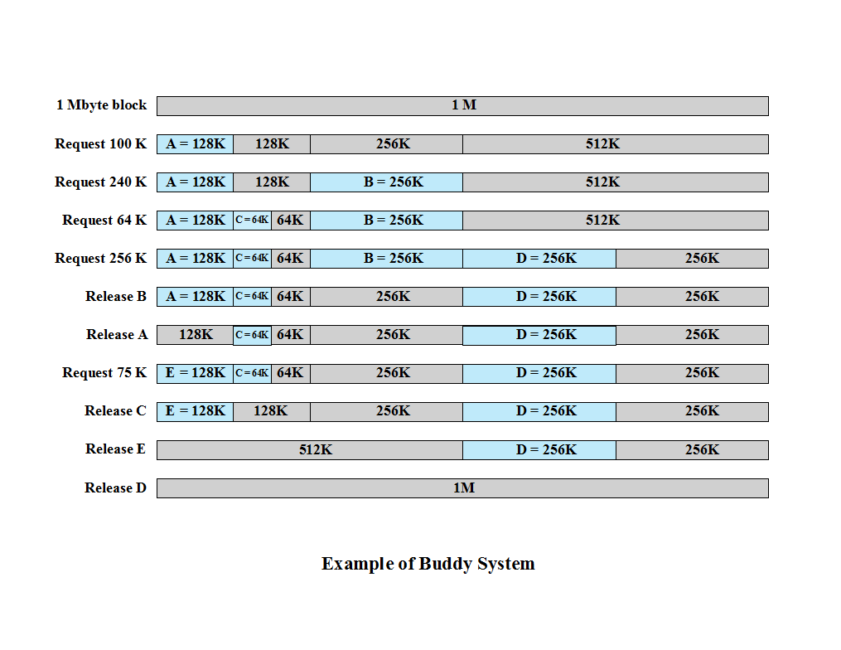
Notes:
Figure 7.6 gives an example using a 1-Mbyte initial block. The first request, A, is for 100 Kbytes, for which a 128K block is needed. The initial block is divided into two 512K buddies. The first of these is divided into two 256K buddies, and the first of these is divided into two 128K buddies, one of which is allocated to A. The next request, B, requires a 256K block. Such a block is already available and is allocated. The process continues with splitting and coalescing occurring as needed. Note that when E is released, two 128K buddies are coalesced into a 256K block, which is immediately coalesced with its buddy.

Slide 75
Paging
Partition memory into equal fixed-size chunks that are relatively small
Process is also divided into small fixed-size chunks of the same size
Pages
chunks of a process
Frames
available chunks of memory
Notes:
Both unequal fixed-size and variable-size partitions are inefficient in the use of memory; the former results in internal fragmentation, the latter in external fragmentation. Suppose, however, that main memory is partitioned into equal fixed-size chunks that are relatively small, and that each process is also divided into small fixed-size chunks of the same size. Then the chunks of a process, known as pages , could be assigned to available chunks of memory, known as frames , or page frames. We show in this section that the wasted space in memory for each process is due to internal fragmentation consisting of only a fraction of the last page of a process. There is no external fragmentation.

Slide 76
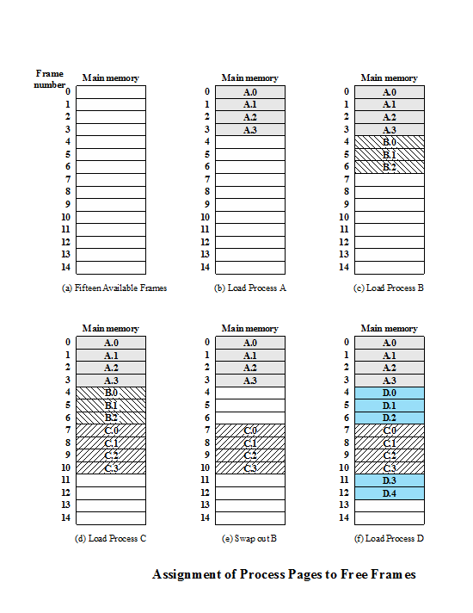

Slide 77
Page Table
Maintained by operating system for each process
Contains the frame location for each page in the process
Processor must know how to access for the current process
Used by processor to produce a physical address
Notes:
A simple base address register will no longer suffice. Rather, the operating system maintains a page table for each process. The page table shows the frame location for each page of the process. Within the program, each logical address consists of a page number and an offset within the page. Recall that in the case of simple partition, a logical address is the location of a word relative to the beginning of the program; the processor translates that into a physical address. With paging, the logical-to-physical address translation is still done by processor hardware. Now the processor must know how to access the page table of the current process. Presented with a logical address (page number, offset), the processor uses the page table to produce a physical address (frame number, offset).

Slide 78
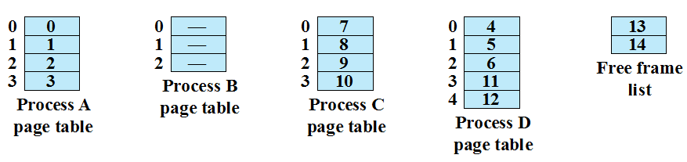
Page Table: An Example @ time (f)
Notes:
Page Table Examples

